Slide 1



SANJAY K 20BCE0020
SANJIT NARAYANAN G 20BCE0052
WIN REVANS B 20BCE0971
DATA ENGINEERING TRAINING
ETL PIPELINE FOR GLOBAL SUPERSTORE DATASET
Aathirainathan P
Ambati Sesha Sai Sahithya
Eswara Venkata Sai Raja

Slide 2

PROJECT OVERVIEW
Leveraged Azure tools to process large-scale retail data.
Key Tools: Azure Data Factory, Databricks, Delta Lake.
Objectives:
Build scalable ETL pipelines.
Perform advanced analytics.
Visualize trends in sales, profit, and regional
performance.

Slide 3
PROJECT REQUIREMENTS
Goal: Create a 3-tier ETL Pipeline (Bronze, Silver, Gold zones).
Process:
Extract data from Azure Blob Storage.
Transform & clean data using Azure Databricks.
Analyze & visualize results.
Key Deliverables:
Scalable data ingestion and transformations.
Trusted, clean dataset for analytics.

Slide 4
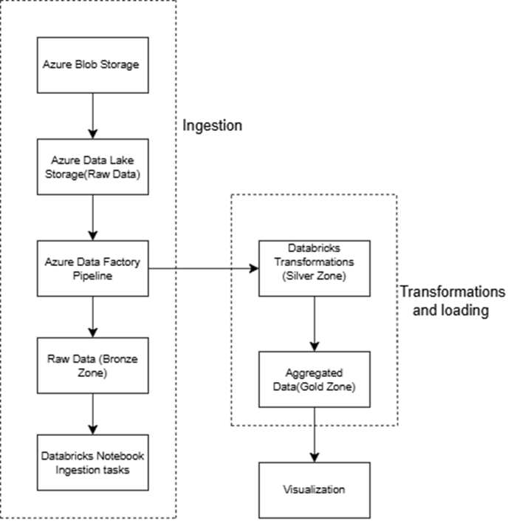
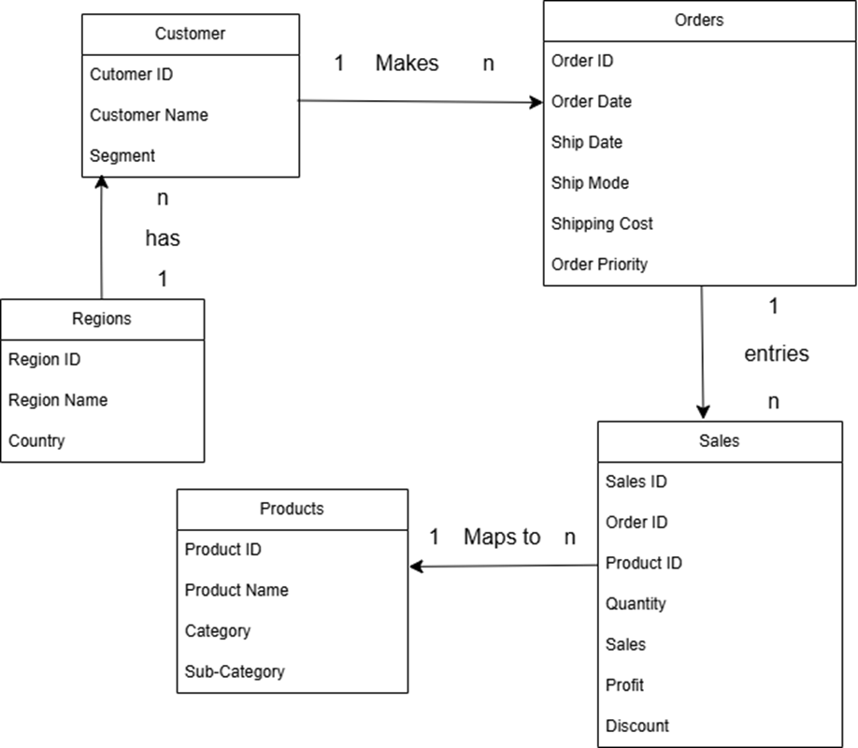
Architectural & ER Diagram

Slide 5
Workflow:
Step 1: Ingestion (Bronze Zone):
Upload data to Azure Blob Storage.
Copy data to Azure Data Lake Storage.
Step 2: Transformation (Silver Zone):
Cleaning, deduplication, type conversions, and filtering.
Step 3: Analytical Zone (Gold Zone):
Aggregate data by region, category, and year.
Compute metrics: Profit margin, discount trends, sales growth.

Slide 6
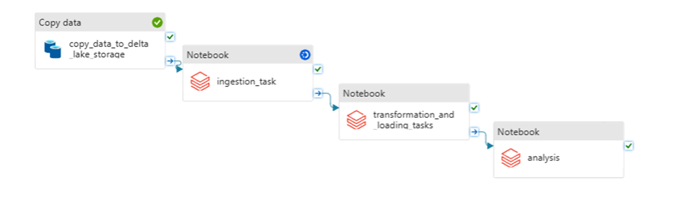
DESIGN

Slide 7
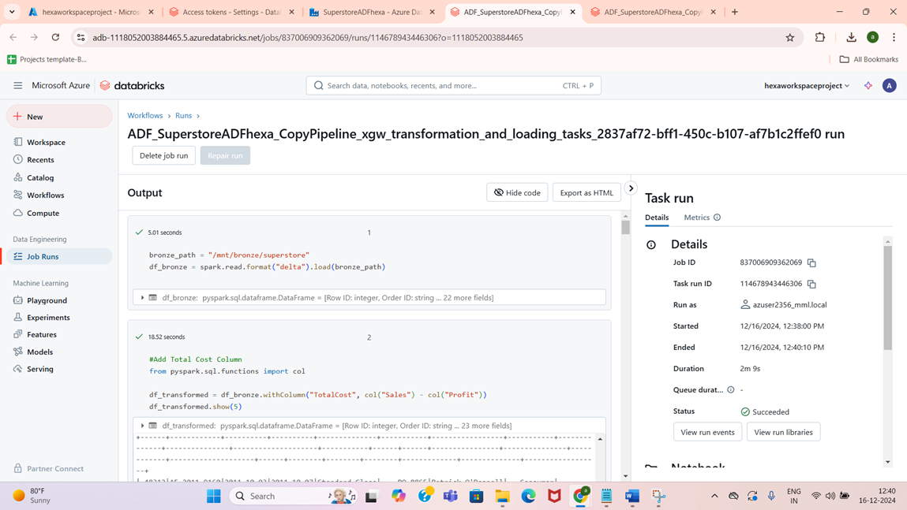
TASKS DONE

Slide 8
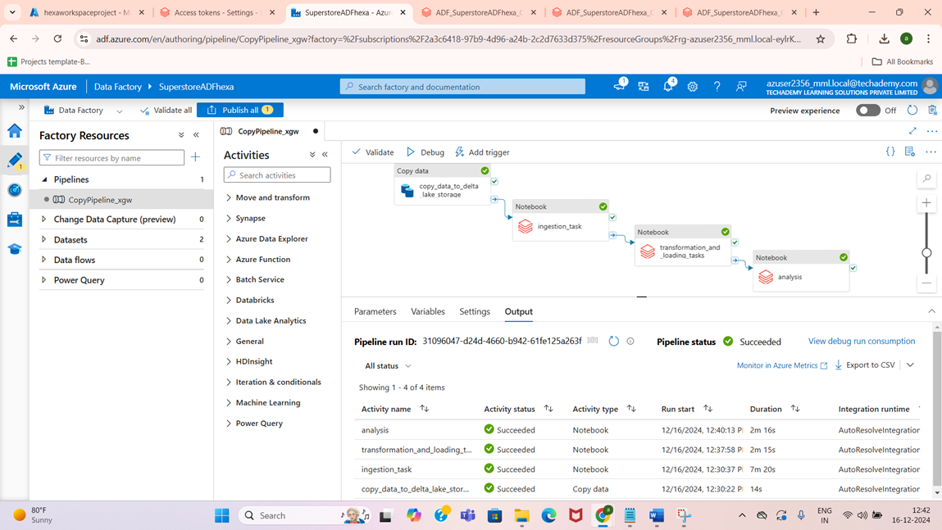
TASKS DONE

Slide 9
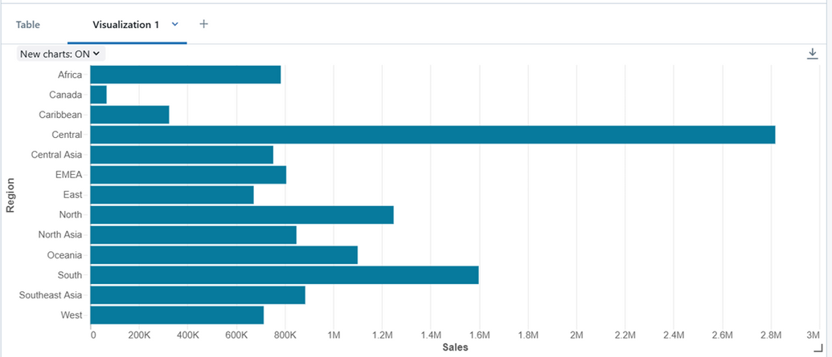
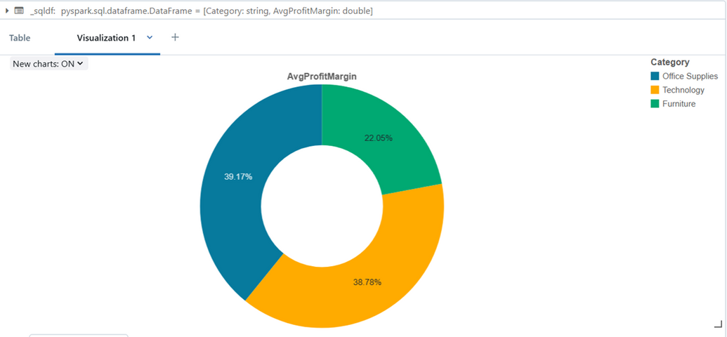
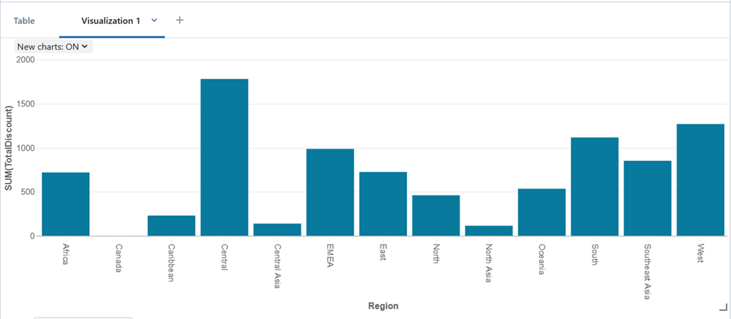
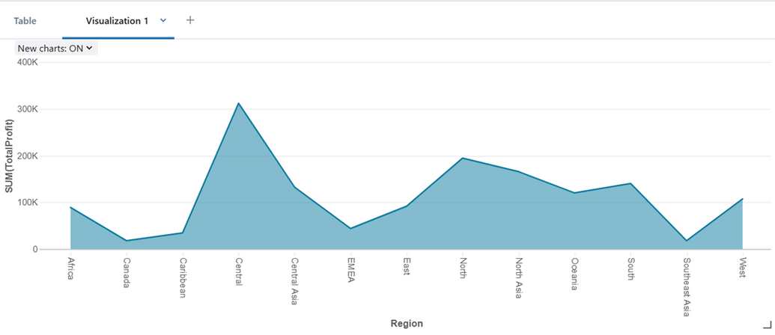
ANALYSIS & VISUALIZATIONS

Slide 10
CONCLUSION
Successfully built a scalable ETL pipeline.
Enabled clean data analysis and business insights.
Highlighted performance metrics to assist decision-making.

Slide 11

SANJAY K 20BCE0020
SANJIT NARAYANAN G 20BCE0052
WIN REVANS B 20BCE0971
THANK YOU
Submitted By:
Eswara Venkata Sai Raja

